Slide 1
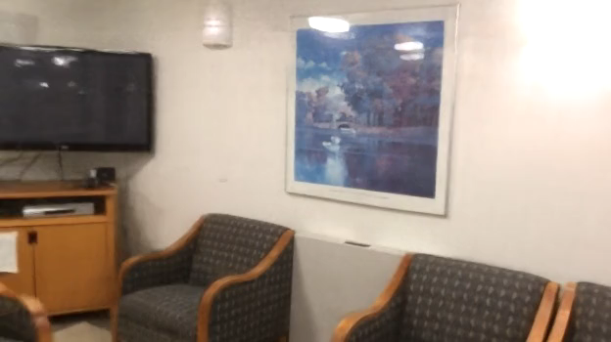
Dense Depth Priors for Neural Radiance Fields from Sparse Input Views
18 images

Slide 2
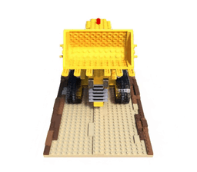
Mildenhall et al. “NeRF: Representing Scenes as Neural Radiance Fields for View Synthesis” ECCV 2020
Neural Radiance Fields (NeRF) on 100 images

Slide 3
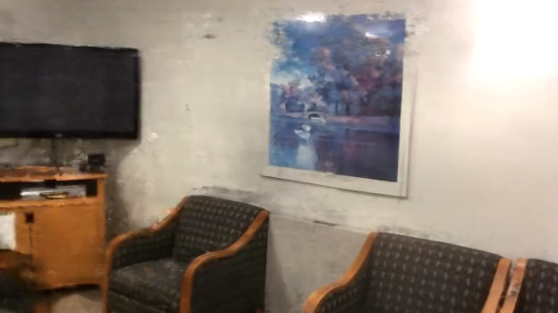
NeRF on 18 images of an entire room

Slide 4

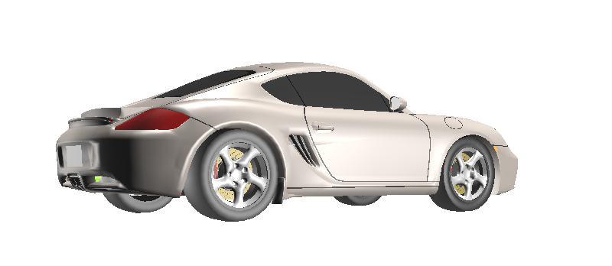


How is NeRF doing multi-view stereo?
The case of few images is underconstraint.
Can depth input help constrain the optimization?
Ray 1:
$$σ$$
$$z$$
Surfaces
Ray 1

Slide 5
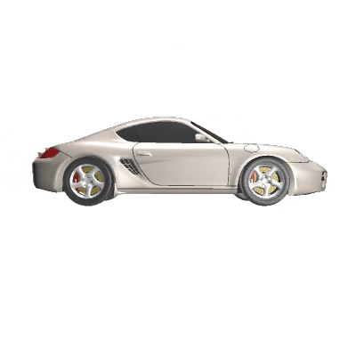
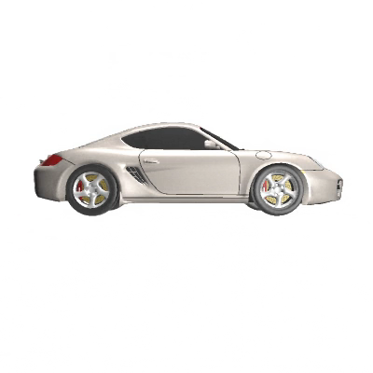
NeRF with depth input on 4 views.
without depth loss
with depth loss

Slide 6
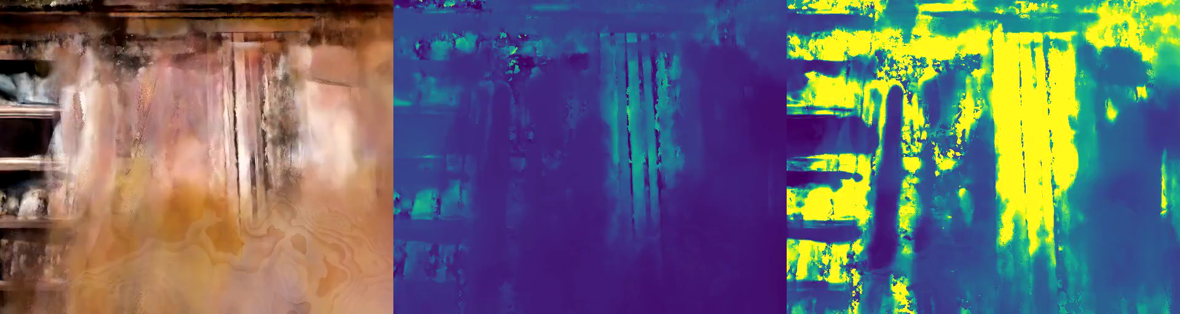

NeRF with depth input on 36 views.
without depth loss
with depth loss
→ Problem: Dense, high quality depth maps are not always available.

Slide 7
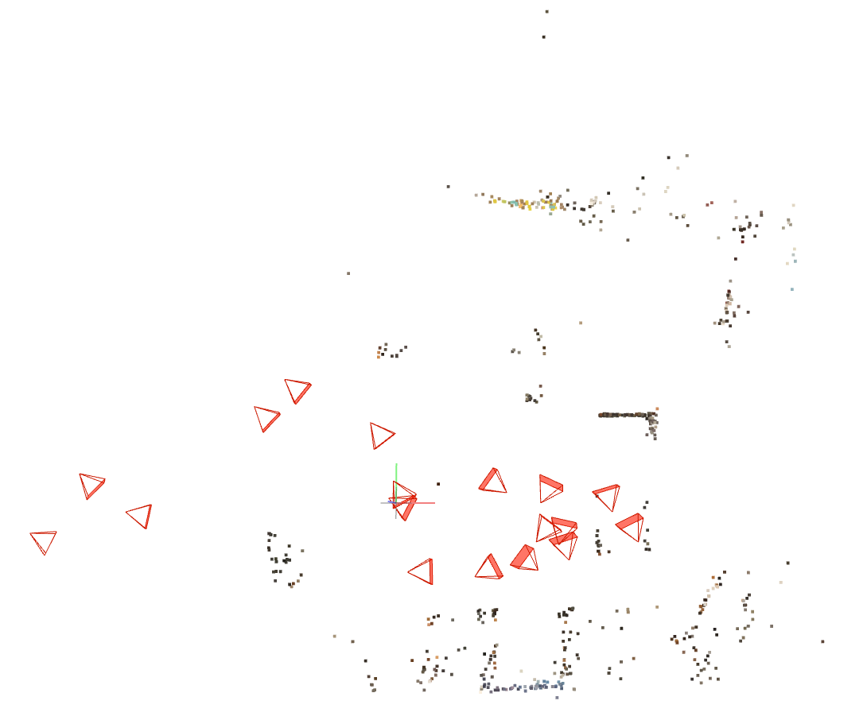
BUT we have sparse depth from SfM for free!
Challenge: SfM reconstructions on few views
are very sparse and very noisy.
Schönberger et al. “Structure-from-Motion Revisited” CVPR 2016

Slide 8


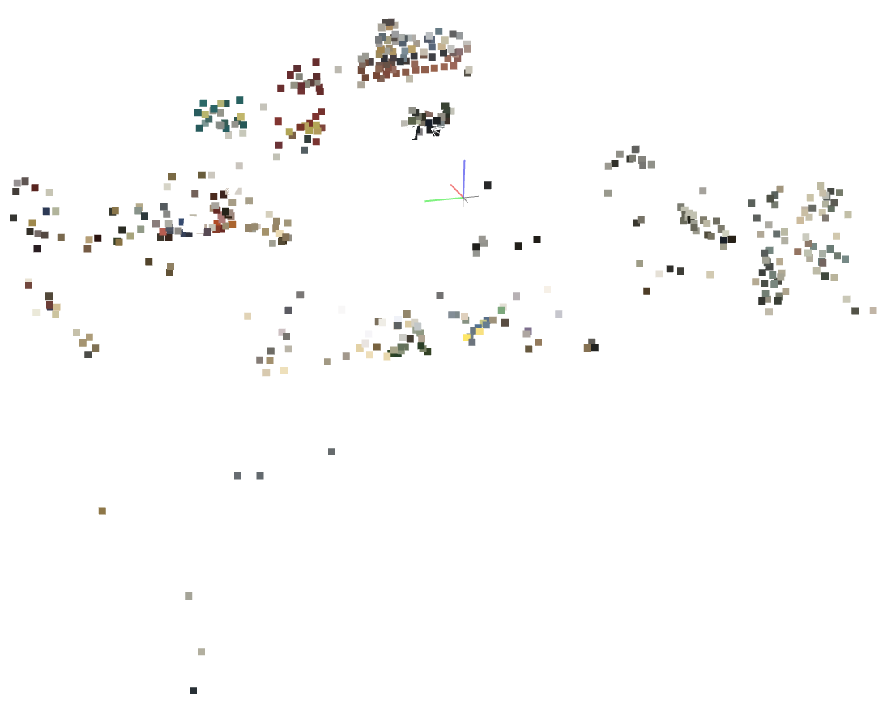
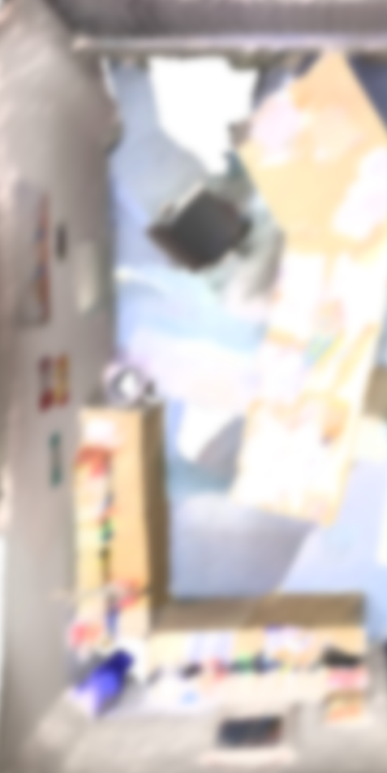
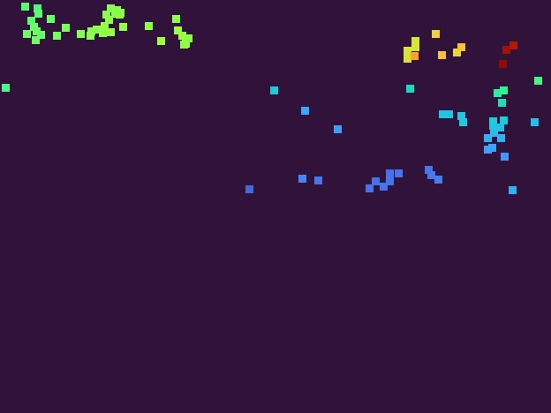
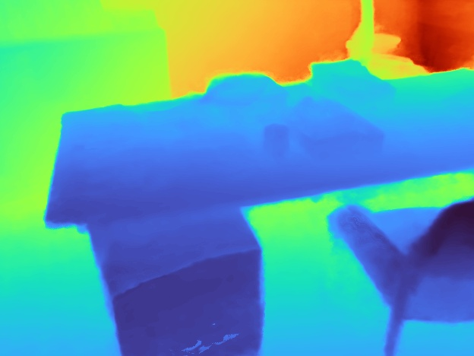


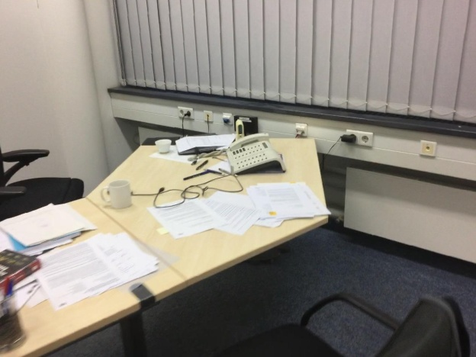
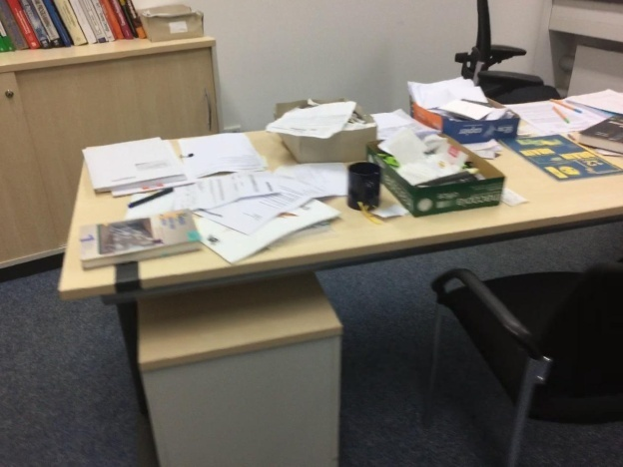

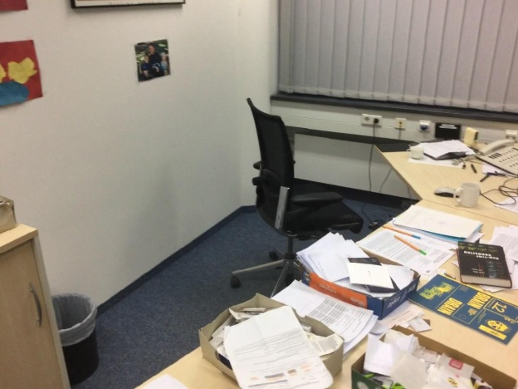
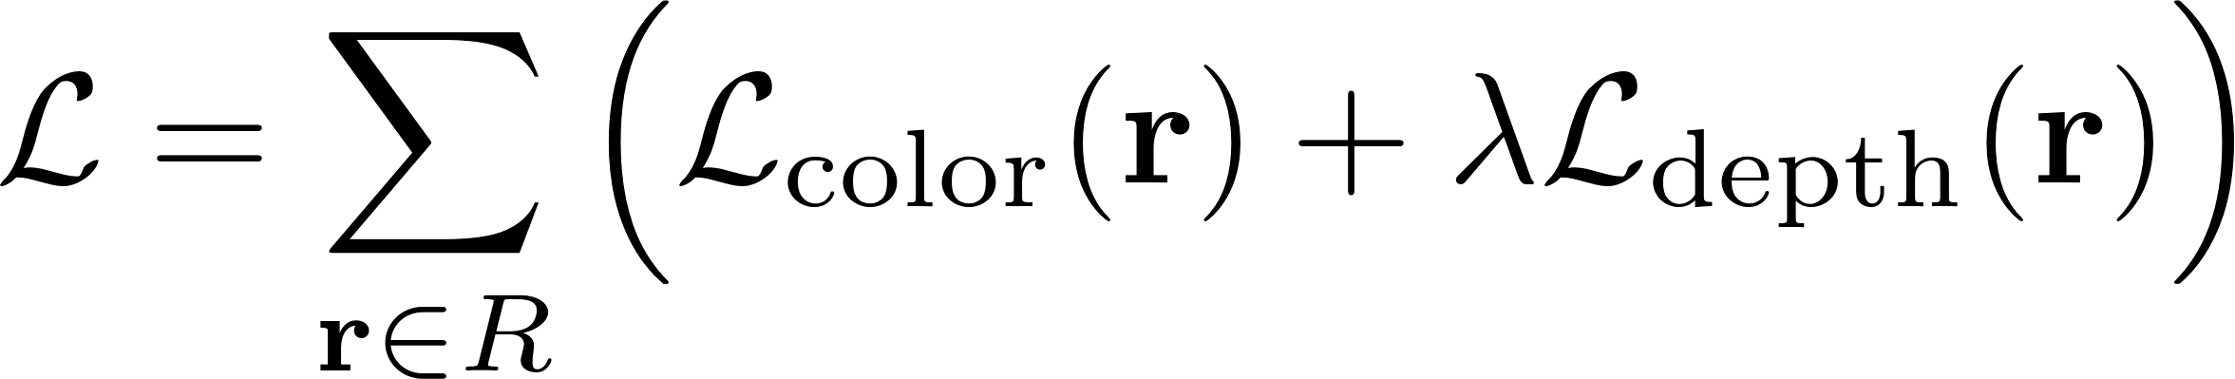
Let‘s use this sparse depth for NeRF.
Point
Cloud
Sampling
Sparse Depth
Depth & RGB
Radiance Field
SfM
Volume
Rendering
Multi-View RGB
…
Mean squared error
Gaussian negative log likelihood

Slide 9
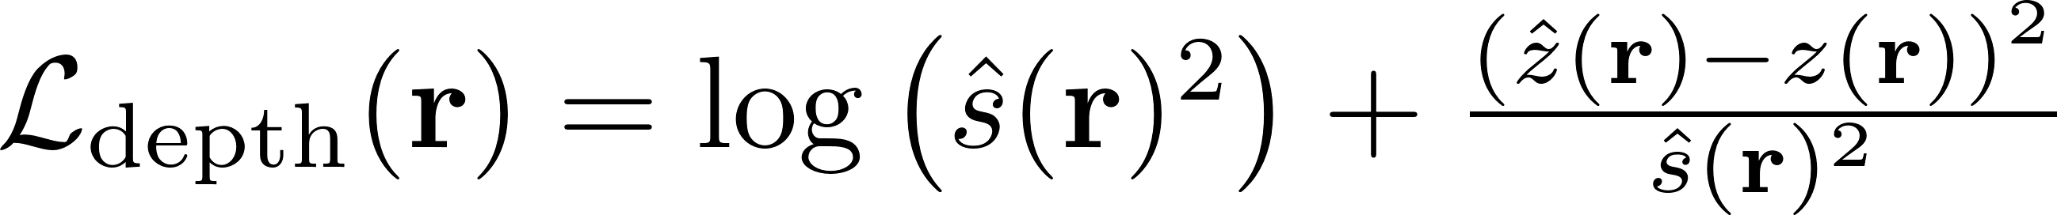
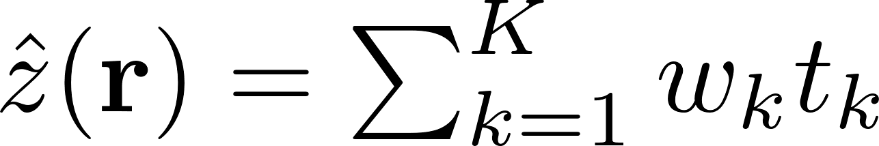
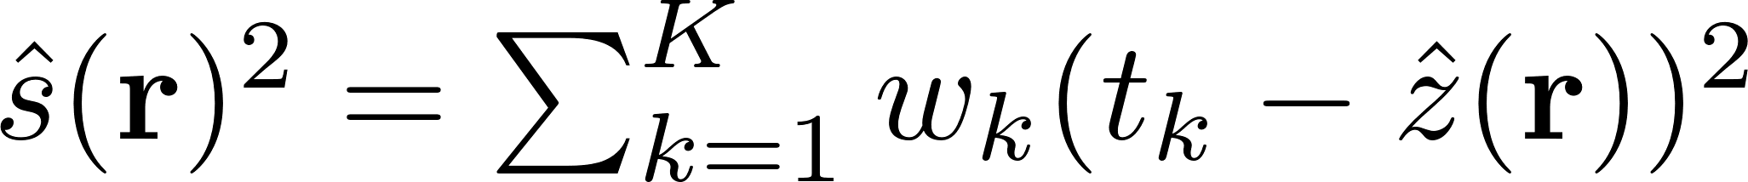
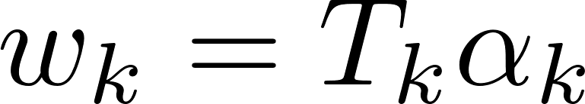
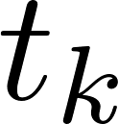
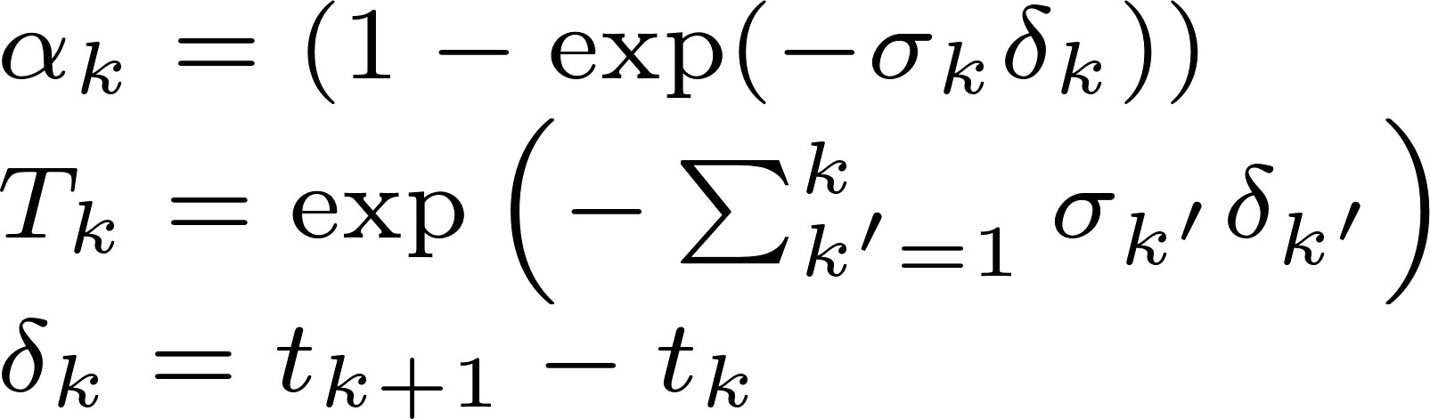
How to supervise with depth?
Sparse Depth
Target:
NeRF Depth Prediction:
Radiance Field

Slide 10
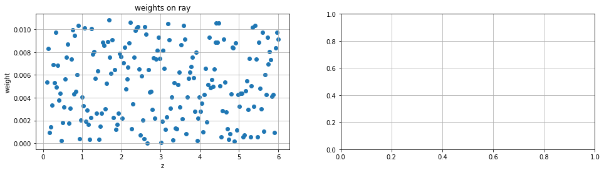
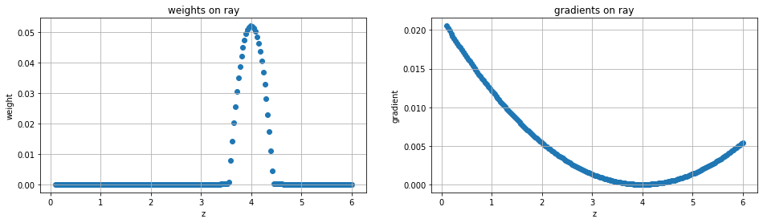
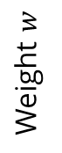
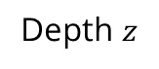
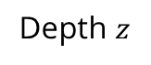
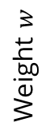
Toy example: GNLL depth supervision
Samples along a camera ray:
Target Depth
Depth
Supervision
Weight $w$
Weight $w$
Depth $z$
Depth $z$

Slide 11
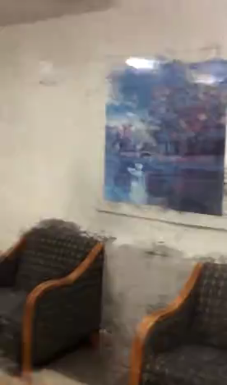
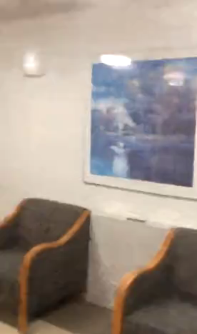
NeRF
NeRF with sparse depth

Slide 12
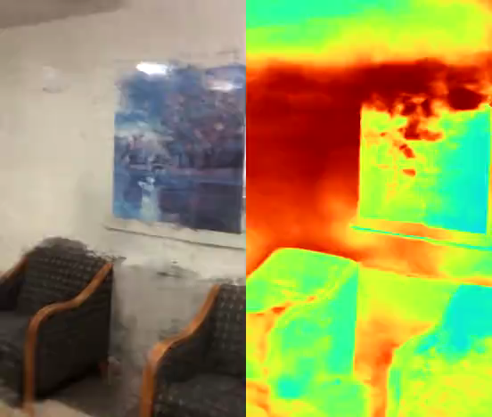
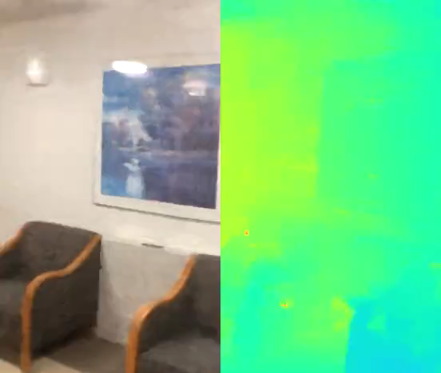
NeRF
NeRF with sparse depth

Slide 13
Results on ScanNet
Method | PSNR ↑ | SSIM ↑ | LPIPS ↓ | Depth RMSE ↓ [m]
NeRF | 19.0 | 0.670 | 0.398 | 1.16
w/ sparse depth | 20.4 | 0.707 | 0.366 | 0.53
→ Can we make better use of sparse depth for NeRF?

Slide 14
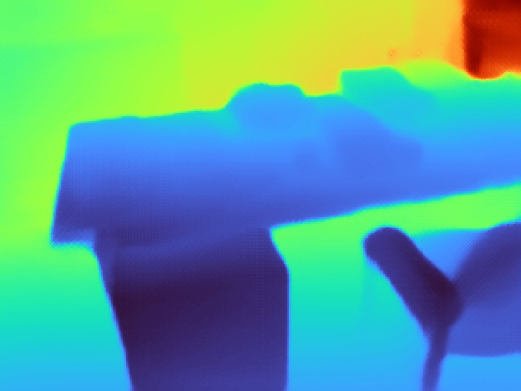
Depth prediction or completion?
Depth
Prediction
→ Inconsistent scale
Depth
Completion
+
→ Consistent scale

Slide 15

Let‘s complete the SfM sparse depth.
Radiance Field
Point
Cloud
Depth & RGB
Sparse Depth
Dense Depth
Volume
Rendering
SfM
Depth Completion
Sampling
Multi-View RGB
…

Slide 16
How to supervise with depth?
Dense Depth
Sparse Depth
Target:
NeRF Depth Prediction:
Radiance Field

Slide 17
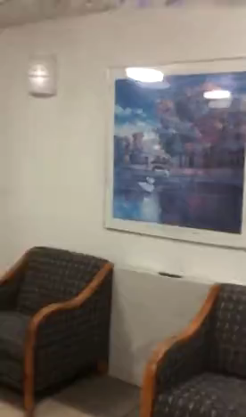
NeRF
NeRF with sparse depth
NeRF with completed depth

Slide 18
Results on ScanNet
Method | PSNR ↑ | SSIM ↑ | LPIPS ↓ | Depth RMSE ↓ [m]
NeRF | 19.0 | 0.670 | 0.398 | 1.16
w/ sparse depth | 20.4 | 0.707 | 0.366 | 0.53
w/ completed depth | 20.1 | 0.714 | 0.308 | 0.28

Slide 19
NeRF
NeRF with sparse depth
NeRF with completed depth

Slide 20
Recall: SfM on few views is noisy and sparse.
Can we improve by considering uncertainty?
Noisy!
Sparse!
Schönberger et al. “Structure-from-Motion Revisited” CVPR 2016

Slide 21
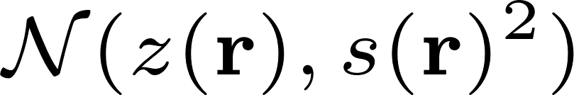
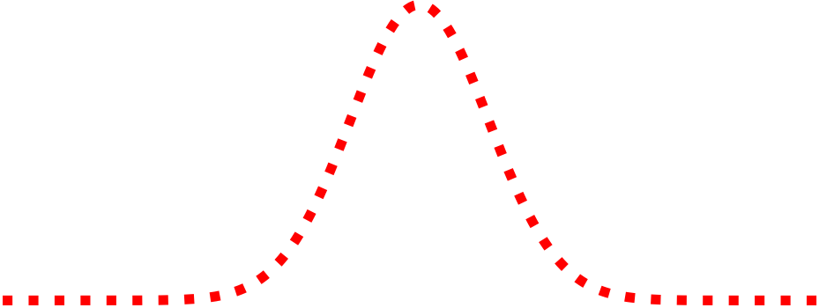
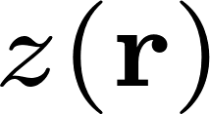
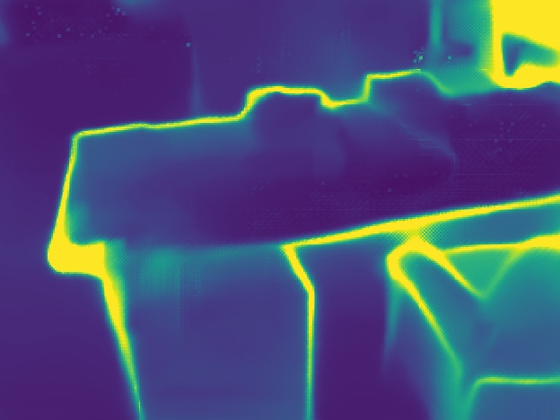

Let‘s learn dense depth priors with uncertainty.
Dense Depth
& Uncertainty
Radiance Field
Point
Cloud
Depth & RGB
Sparse Depth
Volume
Rendering
SfM
Depth Completion
Depth Guided Sampling
Multi-View RGB
…

Slide 22

How to supervise with depth?
Dense Depth
Target:
& Uncertainty
NeRF Depth Prediction:
Radiance Field

Slide 23
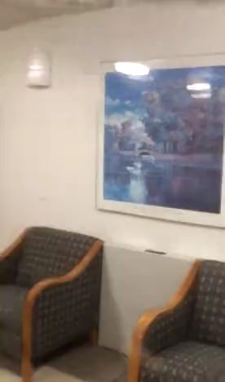
NeRF with completed depth
NeRF with completed depth & uncertainty

Slide 24
Results on ScanNet
Method | PSNR ↑ | SSIM ↑ | LPIPS ↓ | Depth RMSE ↓ [m]
NeRF | 19.0 | 0.670 | 0.398 | 1.16
w/ sparse depth | 20.4 | 0.707 | 0.366 | 0.53
w/ completed depth | 20.1 | 0.714 | 0.308 | 0.28
w/ completed depth & uncertainty | 21.0 | 0.737 | 0.294 | 0.24

Slide 25
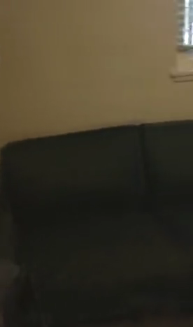
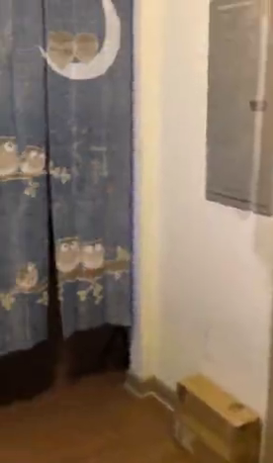
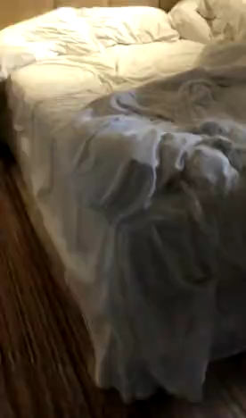
18 images
18 images
14 images
25

Slide 26



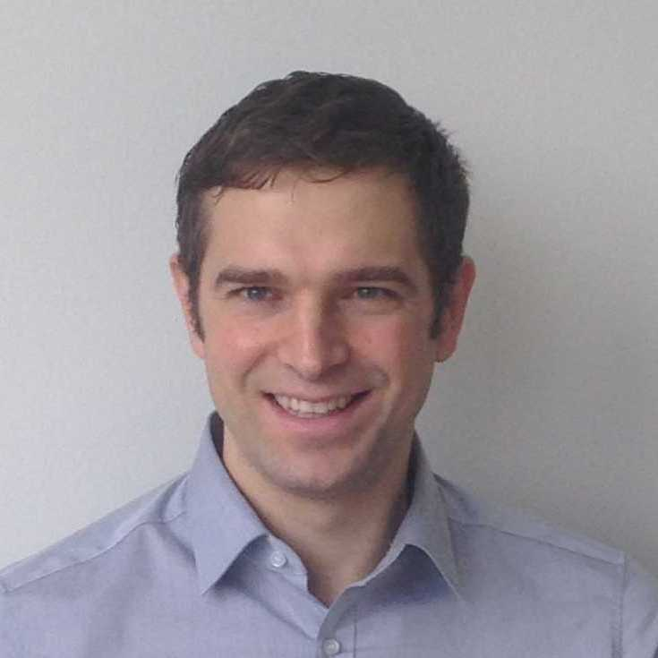
Many thanks to my advisors!
Jonathan T. Barron, Ben Mildenhall, Pratul P. Srinivasan, Matthias Niessner

